Slide 1

Identity in your Web API
Learn to Produce Effective Web APIs with ASP.NET 6

Slide 2
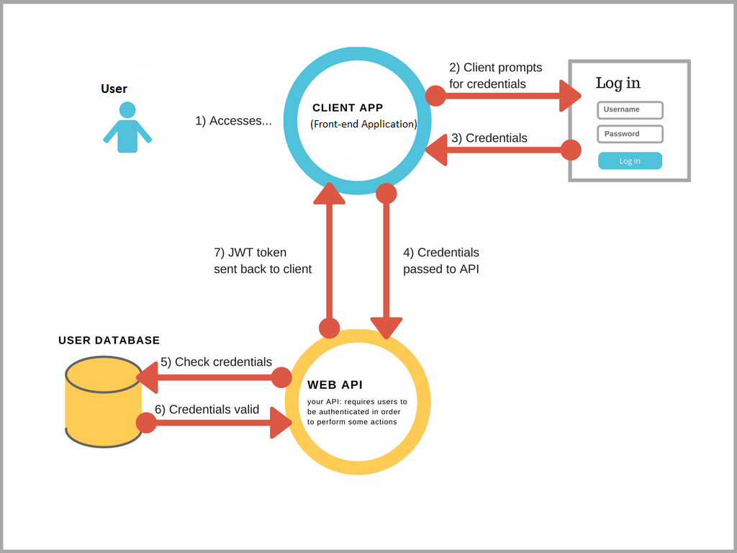
What is happening?

Slide 3
Other ways to provide Identity
Azure Identity and access management (IAM)
ASP.NET Core Identity Provider for Amazon Cognito
Okta and Auth0
IdentityServer 4

